Slide 1
Pattern Direction: Hooke and Jeeves Method
(An Efficient Search Technique for Unconstrained Optimization)
23pw12
Kaushika.c

Slide 2
What is Pattern Direction?
This is a specific direction vector identified during the Exploratory Search that shows the most improvement in function value.
When a point is found to be better than the previous one, this new direction is considered the Pattern Direction.
In the Pattern Move step, the algorithm moves further along this direction in the hope of achieving more improvement.

Slide 3
What is the Hooke and Jeeves Method?
It’s a method that combines two phases to explore and improve the solution step-by-step:
Exploratory Search (Local Search) – Included to explore the local behavior of the objective function.
Pattern Move (Global Search) – Included to take the advantages of pattern direction.

Slide 4
Exploratory Search:
Perturbs the current point along each coordinate axis (positive and negative directions).
Evaluates the objective function at each point.
Identifies if any direction results in improvement (lower function value).

Slide 5
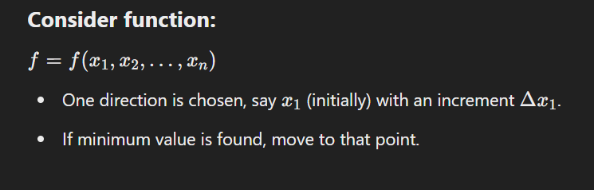

Slide 6
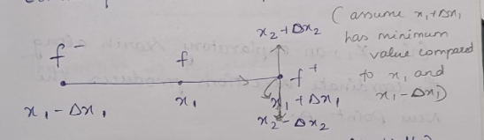
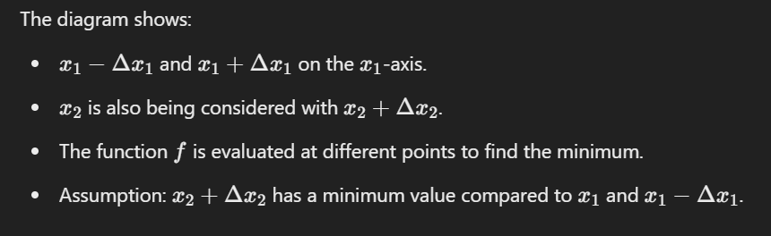

Slide 7
Pattern Move:
When improvement is detected during exploratory search, a larger step is made along the pattern direction.
The step size is adjusted to make faster progress in the search space.
If the pattern move fails, the step size is reduced, and the exploratory search is restarted.

Slide 8
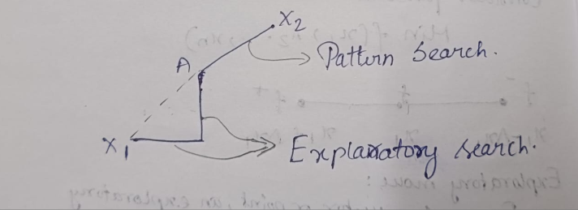
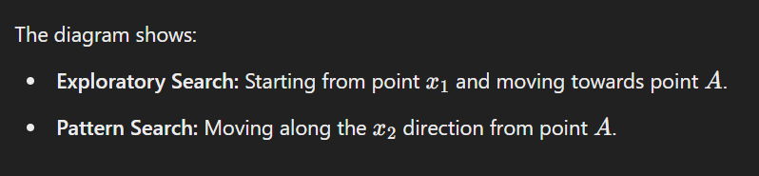

Slide 9
How Pattern Direction Enhances Efficiency:
The pattern direction enhances the efficiency of the Hooke and Jeeves Method by:
Providing a clear direction to take larger steps and make faster progress.
Allowing the search to quickly move away from poor regions of the search space.
Reducing the number of function evaluations needed compared to purely exploratory searches.
Helping achieve faster convergence by combining local searches (exploratory) with guided moves (pattern moves).

Slide 10
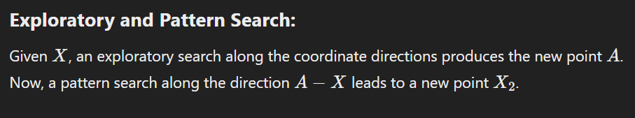

Slide 11
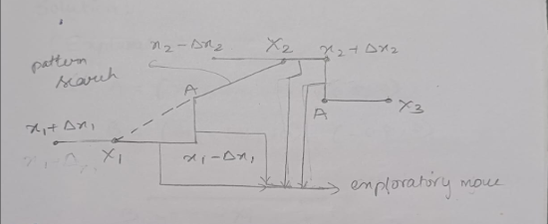

Slide 12
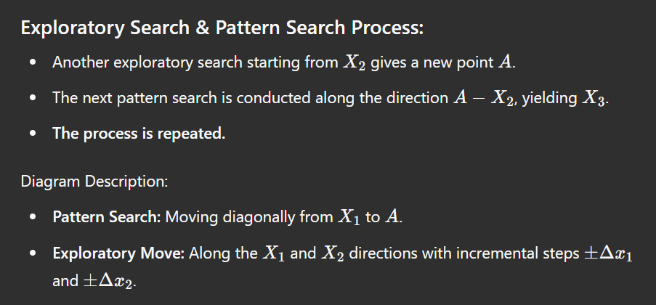

Slide 13
Termination Criterion:
The process continues until a specified small step size is reached or no further improvement is found.

Slide 14
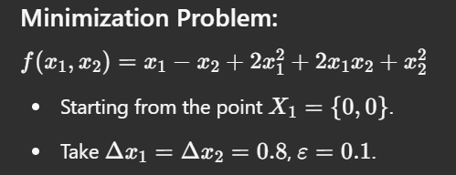
Problem:

Slide 15
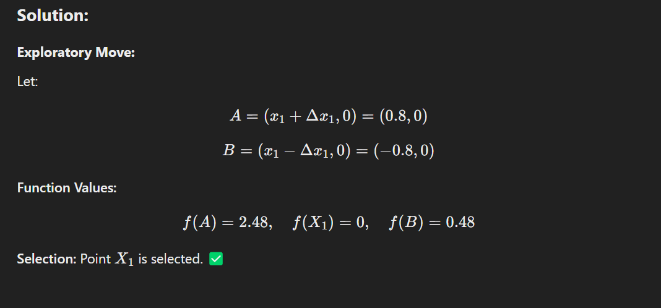
f(A)=2.08

Slide 16
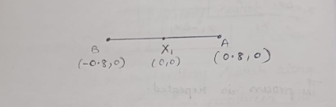

Slide 17
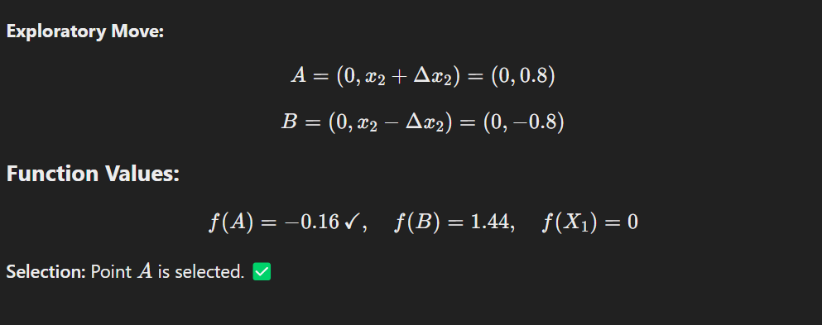
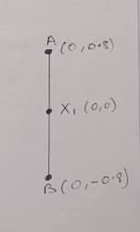

Slide 18
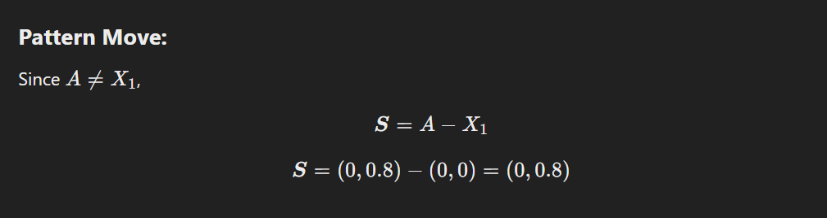
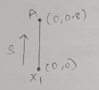

Slide 19
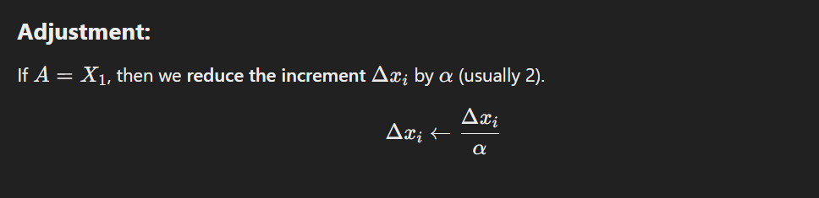

Slide 20

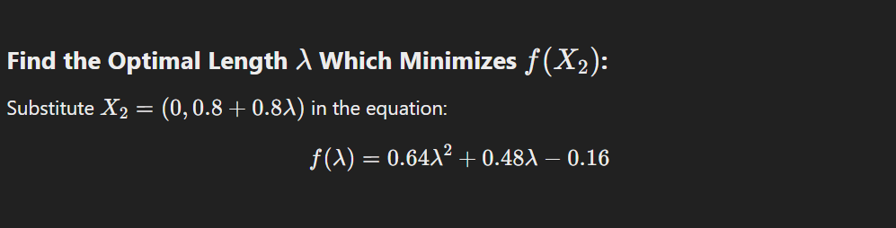

Slide 21




Slide 22
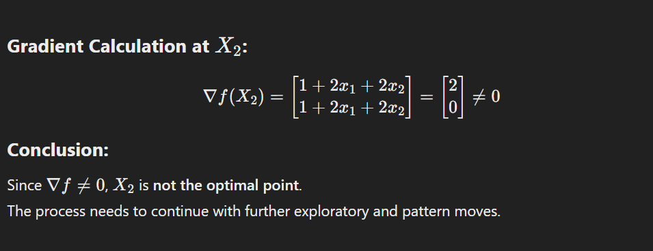

Slide 23
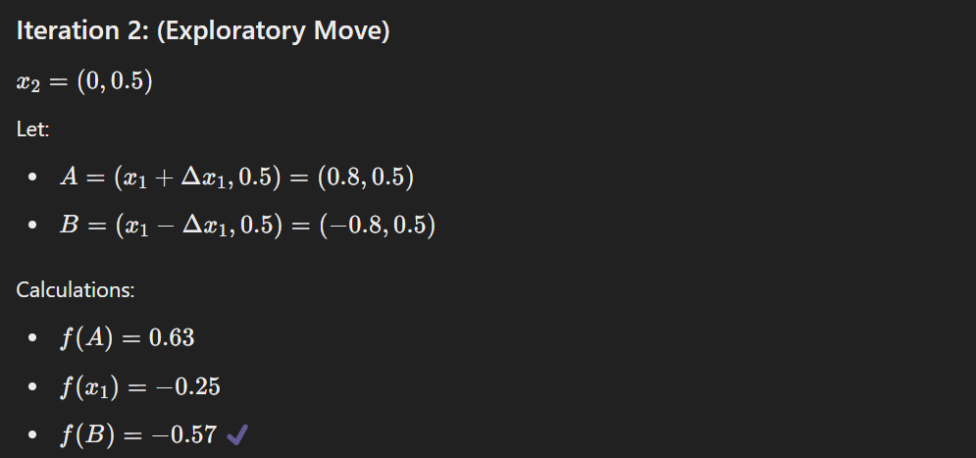

Slide 24
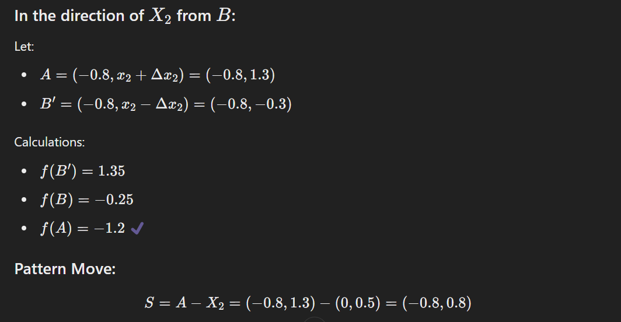
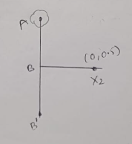

Slide 25
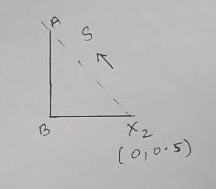
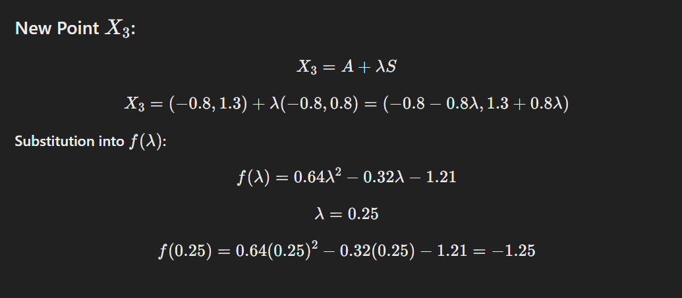

Slide 26
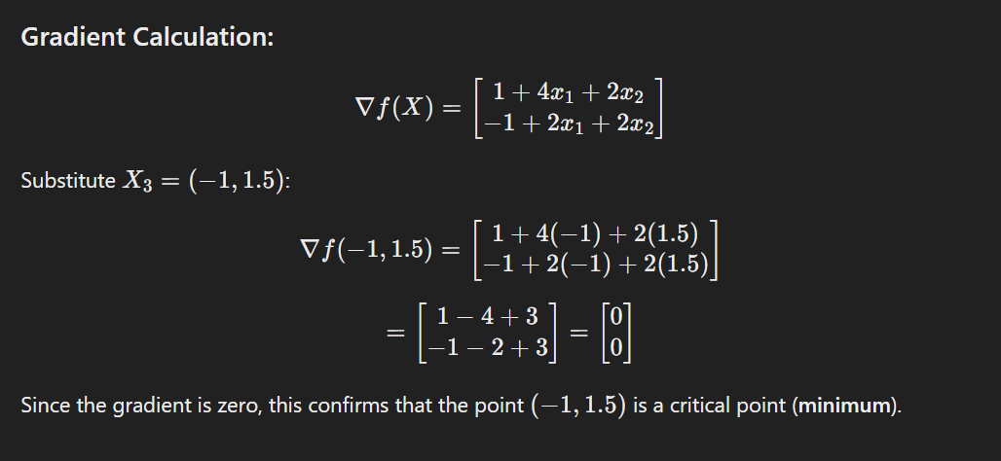

Slide 27
Pattern direction:
Advantages:
Simplicity: Easy to implement since it only involves checking points around the current solution.
No Gradient Calculation Needed: Works without calculating derivatives, making it suitable for non-differentiable or noisy functions.
Local Search Efficiency: Effective at improving the solution by small, localized adjustments.

Slide 28
Disadvantages:
Slow Convergence: Since it’s based on step-by-step exploration, it can take a long time to reach the optimum.
Stuck in Local Minima: The method can get stuck in local minima if the step size is not adjusted properly.
Inefficiency in High Dimensions: As the number of variables increases, the search process becomes inefficient.

Slide 29
Hooke and Jeeves Method :
Advantages:
Faster Convergence: Combines exploratory moves with pattern moves, allowing quicker progress towards the optimum.
Derivative-Free: Doesn't require gradients, making it ideal for functions that are non-differentiable or noisy.
Adaptive Step Size: The step size can be adjusted dynamically, improving efficiency.
Flexible for Complex Functions: Works well even when the function is irregular or has multiple local minima.

Slide 30
Disadvantages:
Sensitive to Initial Step Size: Poor choice of step size can lead to inefficiency or missing the optimum.
Risk of Oscillation: May struggle near narrow valleys or ridges if the step size is not adjusted properly.
Suboptimal for High Dimensions: Performance degrades with an increasing number of variables.
Local Optima Issues: Like the Pattern Direction method, it can get stuck in local minima if not carefully designed.

Slide 31
Conclusion:
The Hooke and Jeeves Method is a powerful direct search technique that makes use of pattern directions to accelerate convergence. By combining exploratory searches with pattern moves, it provides an efficient way to solve unconstrained optimization problems where gradient information is not available.

Slide 32
Reference:
1) Engineering optimization (third edition)
By SS RAO
2) Youtube:
https://youtu.be/-rupdjclC0o?si=74LdH40ni0q9XJ3l

